Slide 1
GUIZHOU TYRE CO.,LTD.
COMPANY PROFILE
July 11, 2022

Slide 2
1
Company Introduction
Preface
Established since 1958
Ranked #28 worldwide in Top Tyre Factories in 2021
Circulation market value reached 5.9 billion USD in 2021
Amount of sales reached 1.12 billion USD in 2021
Largest Specialty Tyre Manufacturer in China

Slide 3
2
Company Introductione
Company Timeline
New Product Line -1ST OTR Tyre Set Produced
Became Public Trading Company Listed in Shenzen Stock Exchange
Started New Tyre Manufacturing Factory Project in Vietnam
New
Product
Stock
Exchange
Vietnam
Factory
1977
1996
2017
1958
1993
2011
2022
Established
Factory
Overseas
Business
New
Factory
Vietnam Factory Reach 1.2M TBR
Established Guizhou Tyre I/E Co., LTD
Start Overseas Business with Worldwide Partners
Established Factory in Guizhou, China 1st Tyre Set Produced
Completed New Factory Project in Mainland China
Chinese Factory Reach 8.13M Capacity including 4 categories.

Slide 4
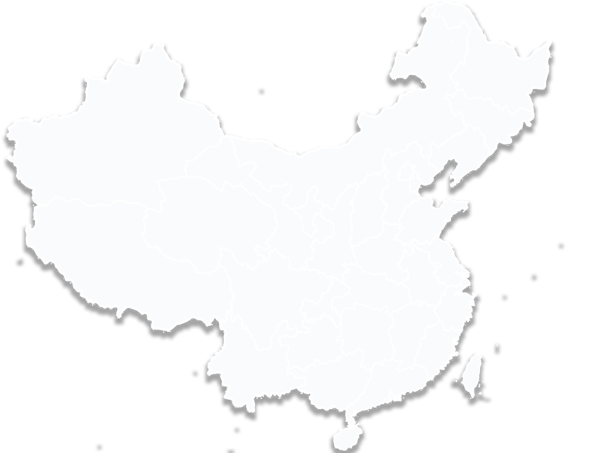
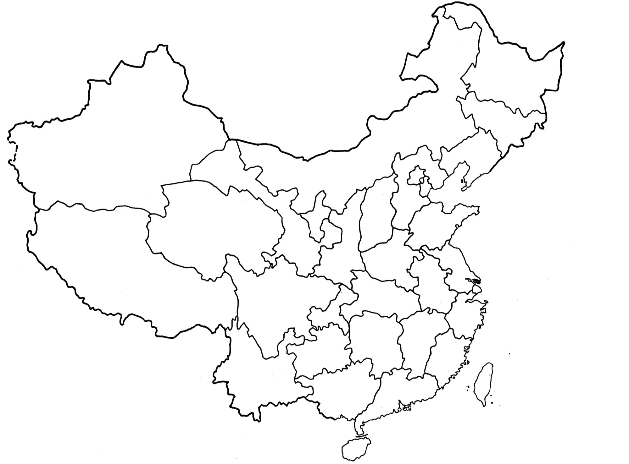
3
Domestic Sales Network
Domestic Sales Network
IN CHINA
BEIJING
HARBIN | CHANGCHUN | SHENYANG | HOHHOT
BEIJING | TAIYUAN | JINNAN | QINGDAO
XINING | LANZHOU | ZHENGZHOU | HEFEI
SHANGHAI | HANGZHOU | NANCHANG | CHANGSHA
XIAMEN | GUANGZHOU | CHENGDU | KASHGAR
BEIJIN
G
GUIZHOU
Guizhou Tire
Products Cover
21 Regions
Guizhou Tire
Products Cover
21 Regions

Slide 5
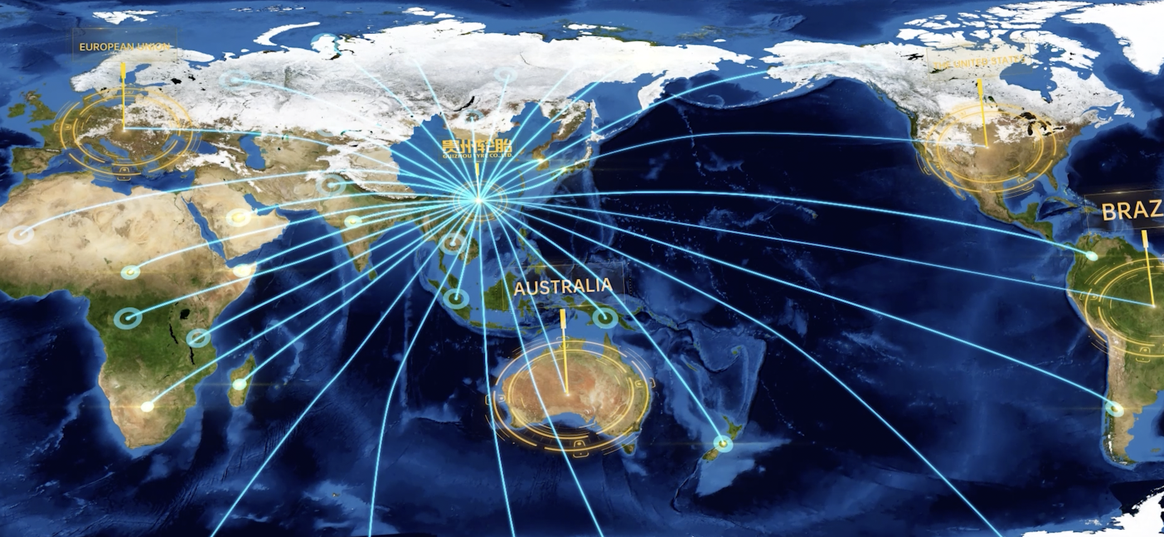
4
Worldwied Sales Network
Available over 130+ countries
IN WORLD
USA | CANADA | MEXICO | BRAZIL
BRITAIN | GERMANY | FRANCE | SPAIN
ITALY | ALGERIA | POLAND | SAUDI ARABIA
MALAYSIA | SOUTH AFRICA | KAZAKHSTAN | SOUTH AFRICA
INDIA | MYANMAR | UAE | VIETNAM
NIGERIA | JAPAN | AUSTRAIA | KENYA
BEIJIN
G
GUZHOU
VITNAM

Slide 6
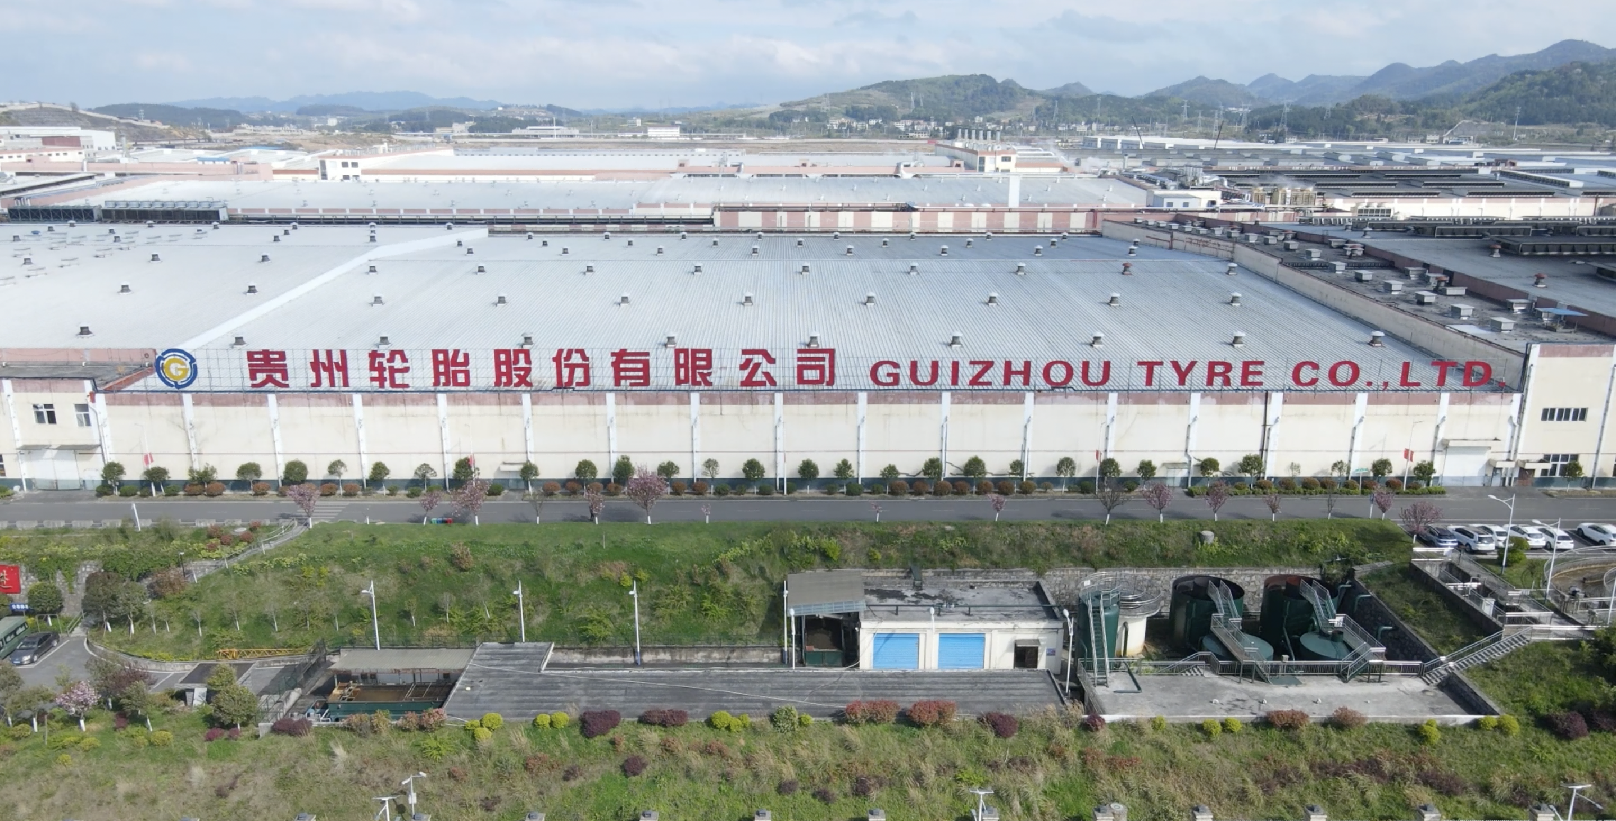
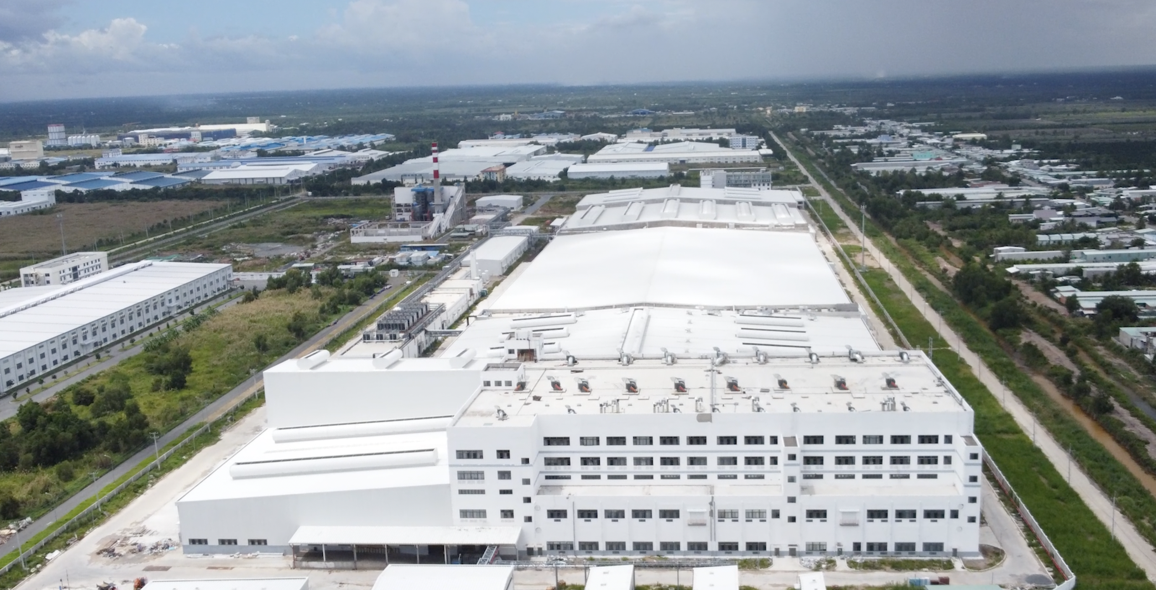
5
Company Introduction
Preface
2 | Two factories: Guizhou / Vietnam
8 | Eight overseas branches: USA/Vietnam/ UK/ Nigeria /Kenya/
Mexico/ Egypt/UAE
26 | OTR /TBR/IND/FARM 26 product categories
30 | 30 worldwide authorized service providers
130 | Product Availability in 130 Countries Worldwide
619 | 619 professionals and technicians
3000 | Complete product line producing over 3,000 specifications
5480 | More than 5,000 employees

Slide 7
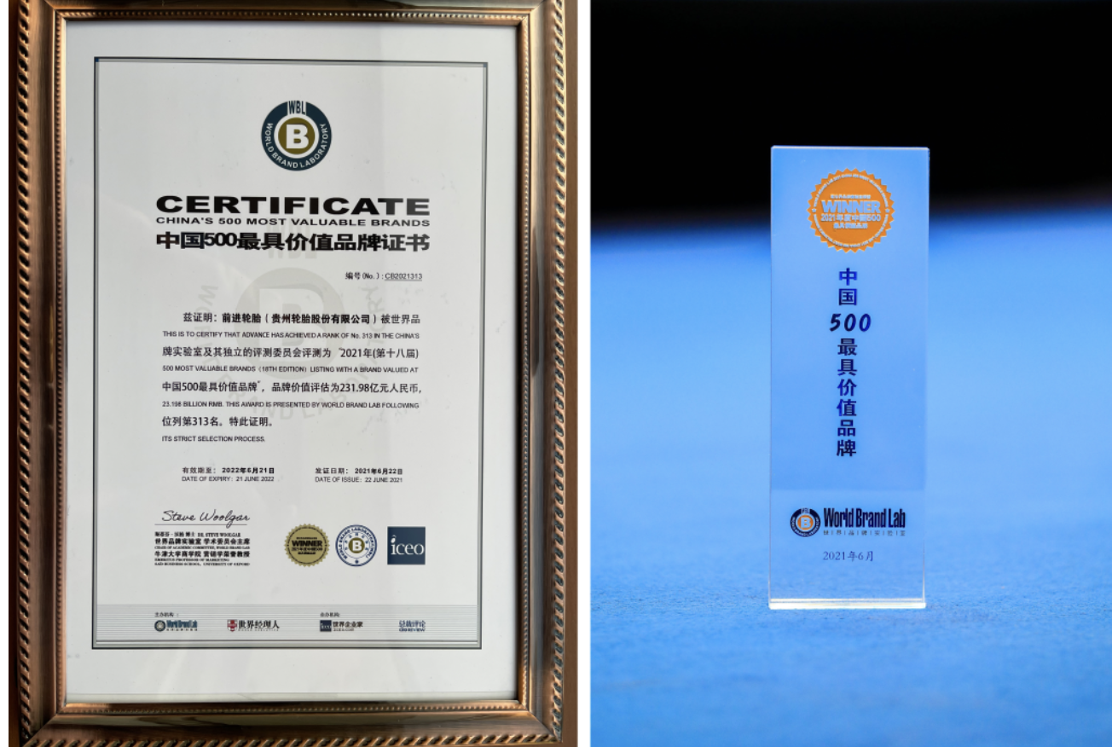
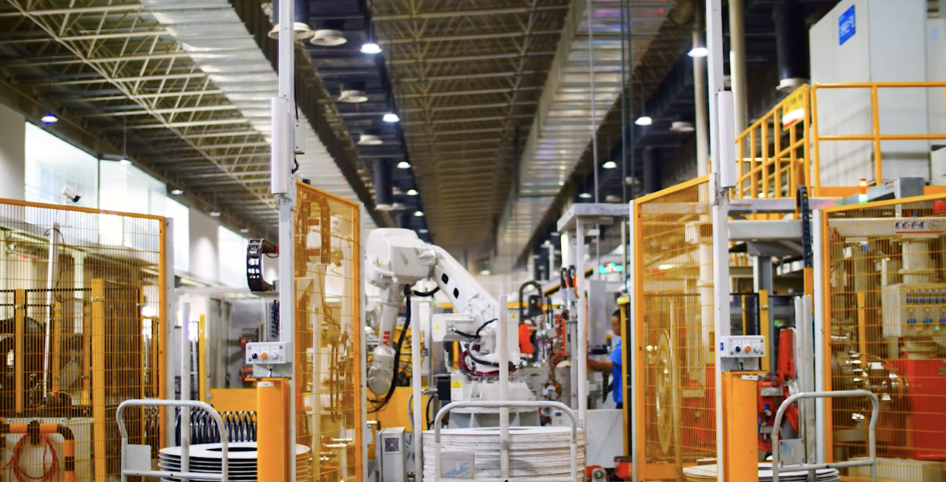
6
Manufacturing based in Guizhou
Established in 1958 and listed in 1996, there are more than 5,000 employees in Guizhou Tyre with an annual output value of more than RMB 8 billion. It has an annual production capacity of more than 8 million sets and more than 3,000 specifications and varieties, which products include truck and bus tires, construction machinery tires, agricultural machinery tires, industrial vehicle tires and special tires, and it is the tire enterprise with the most complete specifications and varieties in China and one of the largest R & D, production and export bases of special and construction machinery tires.

Slide 8
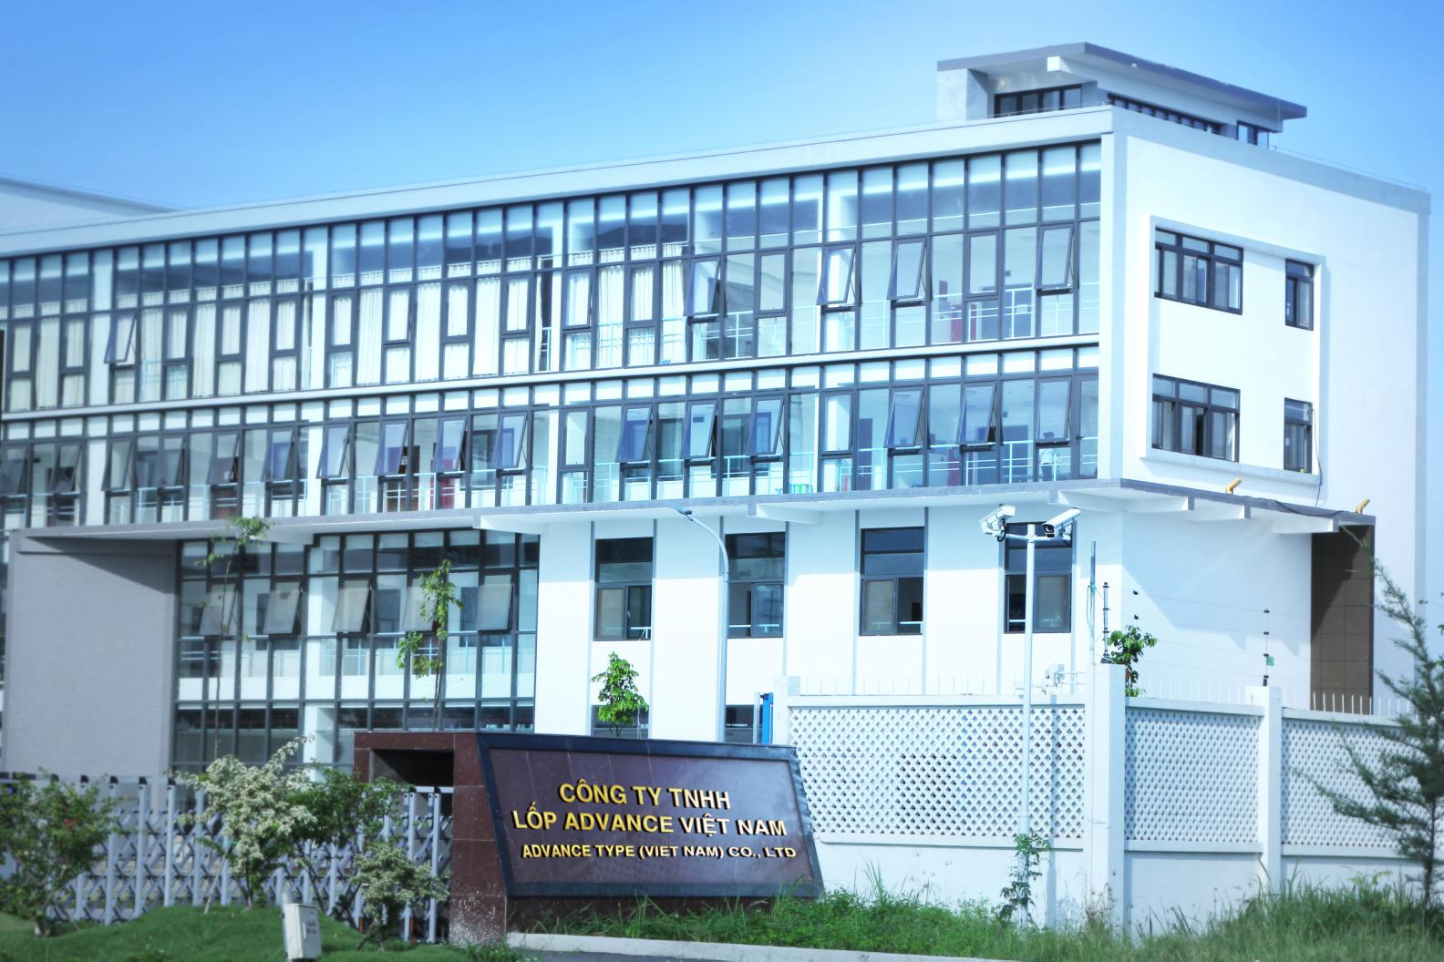
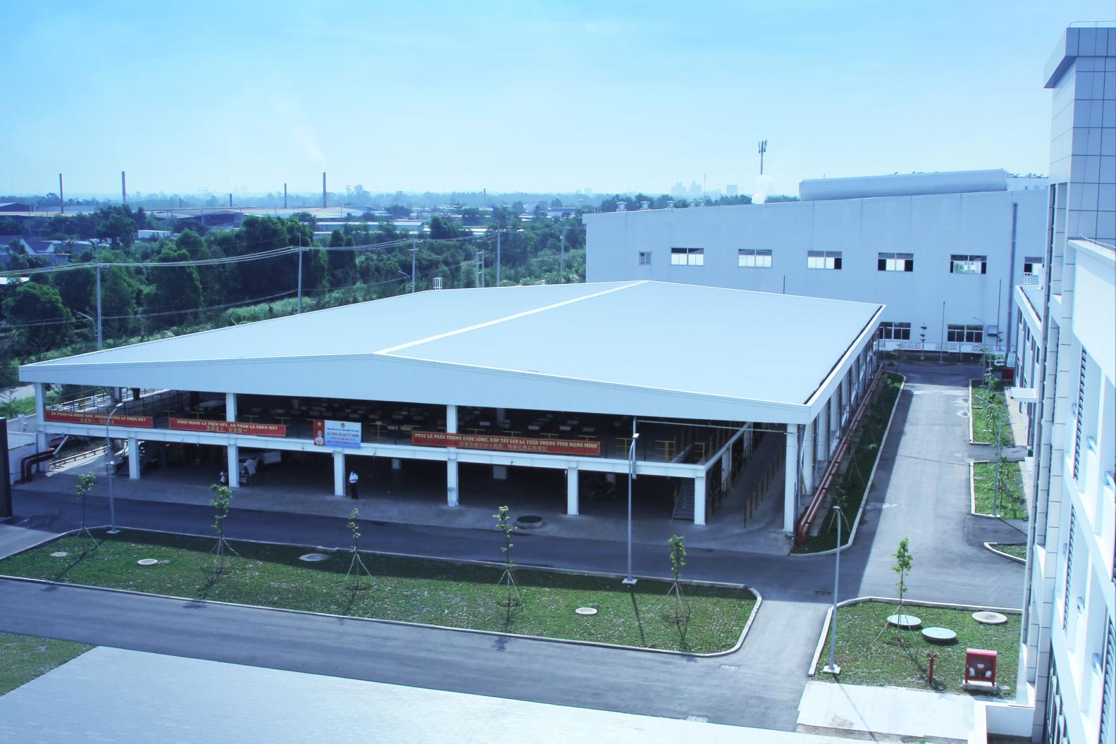
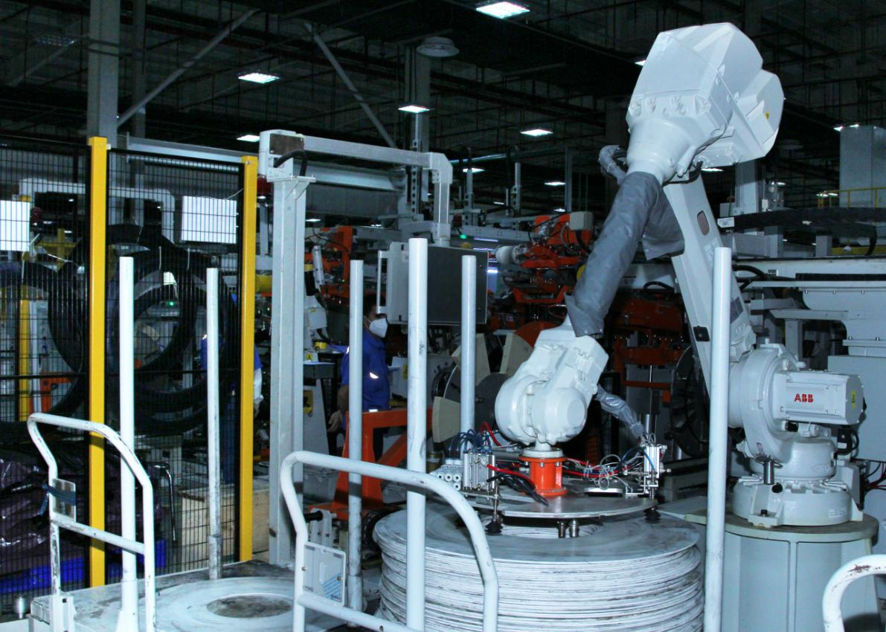
7
Manufacturing based in Vietnam
Located in Vietnam's Tiền Giang Province, Vietnam Factory covers a total area of 29.7 hectares with an investment of about US $400 million. The production capacity of all steel radial tires has reached 1.2 million sets / year by the end of 2022, which will fully meet the market demand.
Vietnam Factory focused on intelligent technology production system, benchmarked with the advanced level in the world, and adopted information-based whole process system, whole process material transportation automation, intelligent environmental protection processing system to ensure product quality, production logistics, transportation allocation and other multi-dimensional integrated management, to create an integrated, fully connected and comprehensive management modern chemical plant from information construction to digital transformation.
has an annual output of 1.2 million sets of all steel truck tires, which has been completed and put into operation

Slide 9
8
Production Capacity
Production Capacity
9.23M
Raial OTR 50 thousand sets per year
Bias OTR 320 thousand sets per year
Radial Farm 110 thousand sets per year
Bias Farm 600 thousand sets per year
TBR 5.25 million sets per year
Industrial 1.7 million sets per year
Vietname 1.2 million TBR
IN YEARLY PRODUCTION

Slide 10
9
Company Certifications
EUROPEAN E MARK
GULF GCC
CHINESE CCC
U.S. D.O.T
SMART WAY
ISO 14001
LAB CNAS
BRAZIL INMETRO
INDONESIA SNI
ECE 22.05

Slide 11
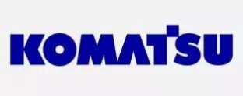
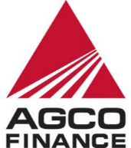
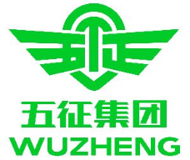
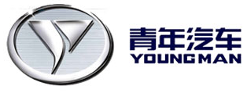
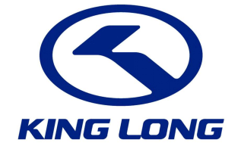
10
Our Partner
OTR
OTR
AGRICULTURE
PORT
BUS&TRUCK

Slide 12
11
Company's philosophy
企业使命
Corporate mission statement
创造价值 回馈社会
Create value, give back to society
企业价值观
Corporate value
诚信敬业、求实进取、创新卓越、利他共赢
Integrity, dedication, innovation, excellence, and altruism
企业愿景
Corporate vision statement
致力于成为全球高安全、高价值轮胎需求客户的首选
Committed to becoming the world's top customer of high-security, high-value tires
企业精神
Enterprise spirit
厂家直销，提供超高性价比增值服务。
拥有快速物流，可提供从选择到修理，所有系列的全覆盖一站式轮胎解决方案
中国一线大厂产品线齐全
我们一直在前进
We are always moving forward

Slide 13
12
Company's philosophy
人才理念
Talent Concept
以人为本、共创共享
People-oriented、sharing
产品品牌理念
Product brand concept
让车轮上的运输更安全
Make transportation on wheels safer
环保理念
Environmental protection concept
绿色制造，为低碳出行保驾护航
Green manufacturing, escorting low-carbon travel

Slide 14
13
Why Choose us
Our Culture
Two bases in Guizhou and Vietnam with flexible production, global service providers’ network, localized delivery and fast service response system
Advanced product design ability, professional customized service, meeting the different demands of commercial tire customers
Industrial 4.0, 5G factory, GTPS fine production, strict production process control and guarantee qualified product performance
4 major series, 26 sub-series, with full product series, maximum commercial tires production base

Slide 15
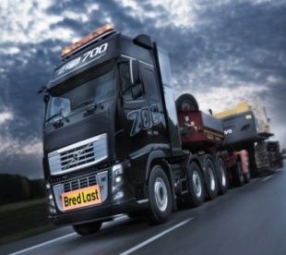
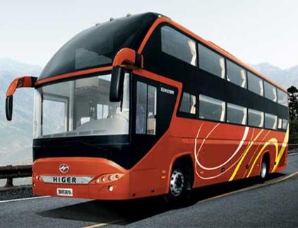
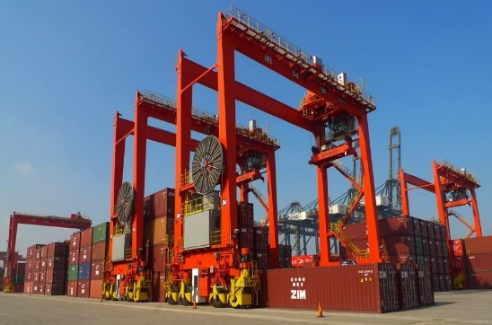
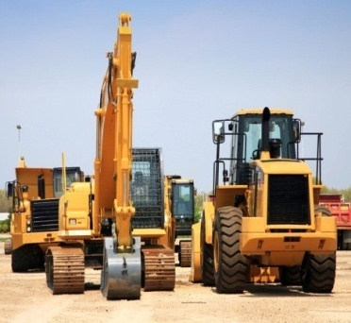
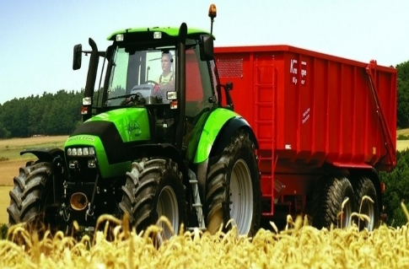
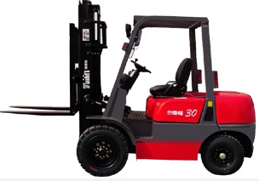
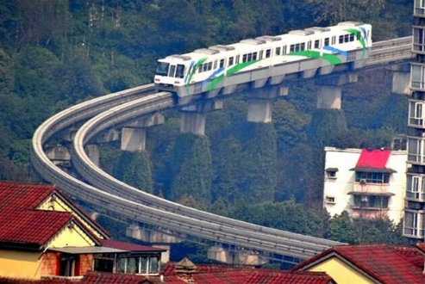
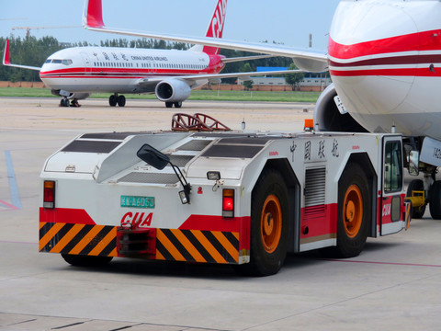
14
Advantage 1： Complete Product Specifications and
Leading Performance in China
There are more than 3,000 specifications and varieties of products in the Company, covering eight sectors. As one of the enterprises with the most complete specifications and varieties of commercial tires in the world, its product performance is leading in China, and it provides customers in various industries around the world with a variety of professional tire solutions and all-round services.
Commercial Truck
Commercial Truck
Passenger Vehicles
Passenger Vehicles
Port Equipment
Engineering Machinery
Commercial Truck
Engineering Machinery
Agricultural Machinery
Agricultural Machinery
Industrial Vehicles
Special Equipment
Airport Equipment

Slide 16
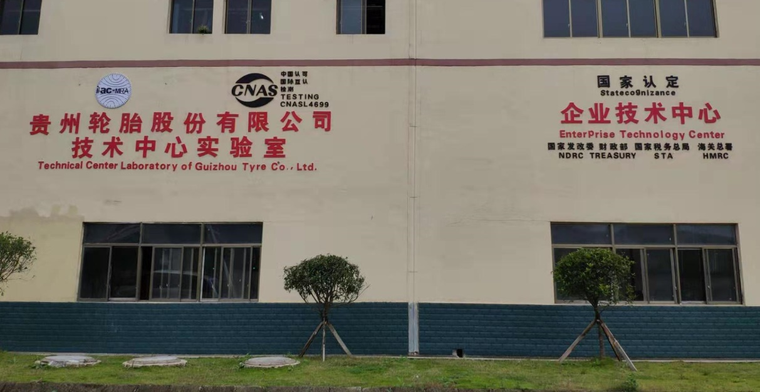
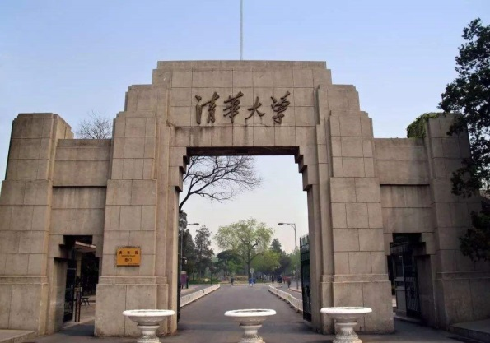
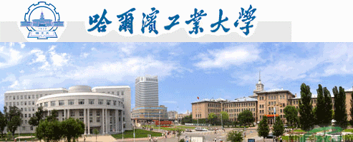
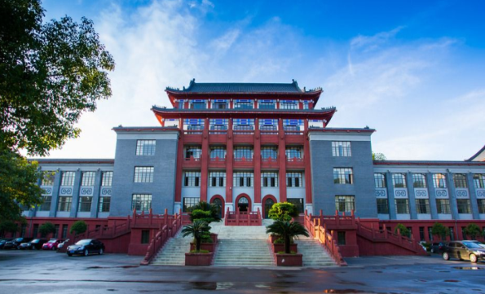
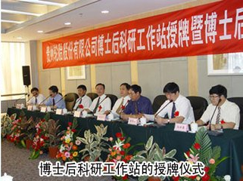
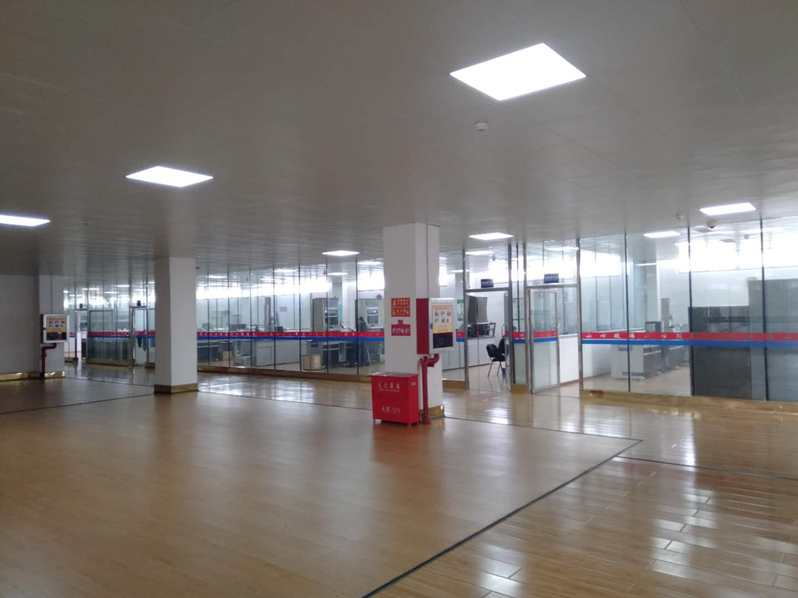
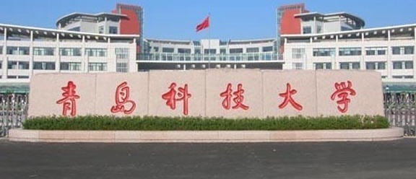
15
Advantage 2： R & D Technical Strength, Leading the Industry
Its annual R & D investment accounts for more than 3.5% of turnover
It has more than 600 R & D personnel undertaking high-quality products and technologies
It has CNAS certified laboratories and advanced means of tire design, testing and analysis
It has a national tire technology R&D center and a postdoctoral workstation
It has long-term exchanges and cooperation with famous universities, such as Tsinghua University, Harbin University of Technology, Sichuan University, etc.

Slide 17
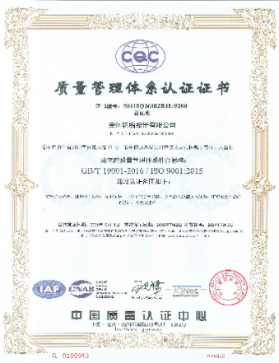
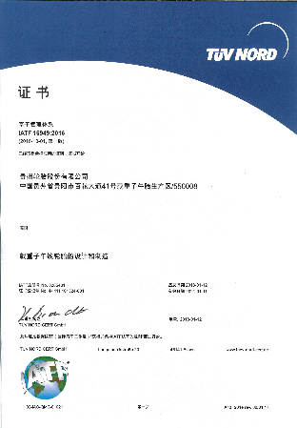
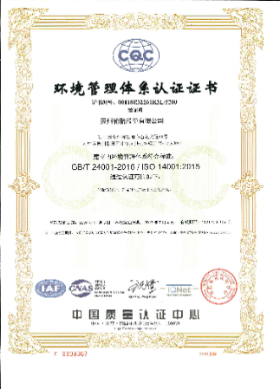
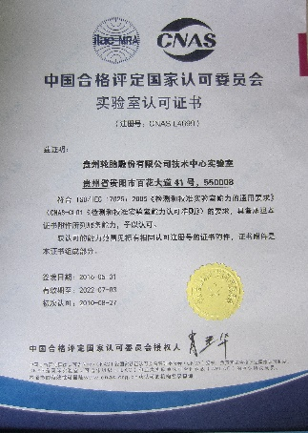
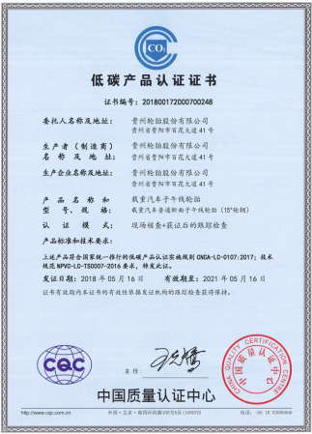
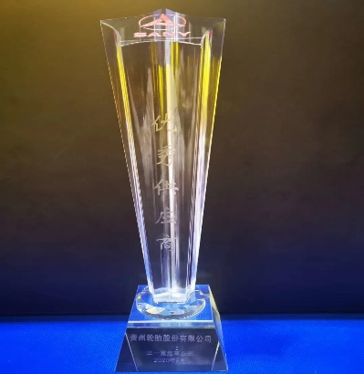
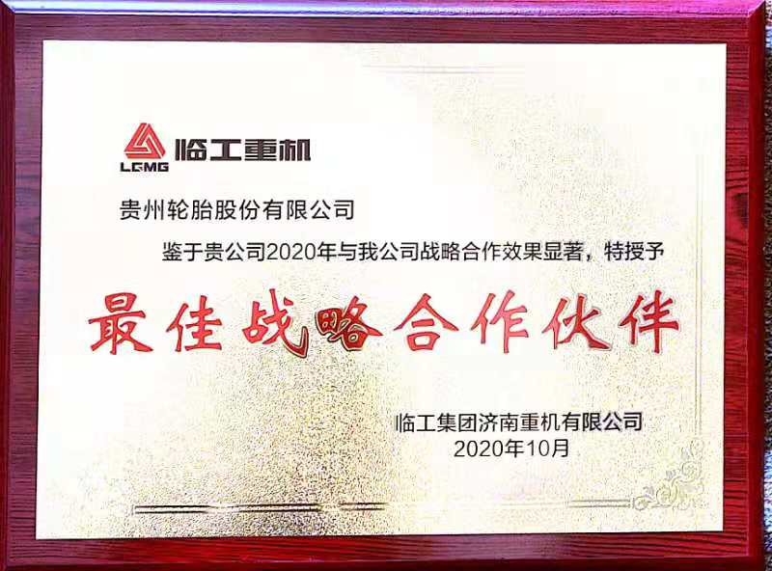
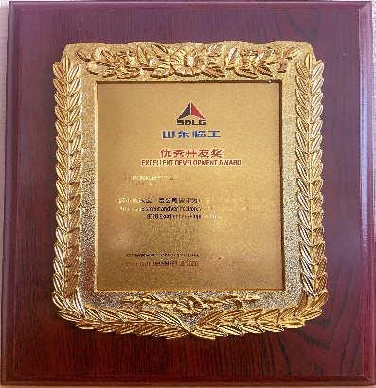
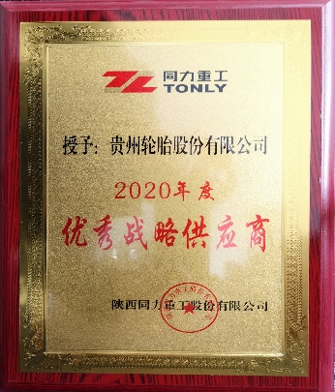
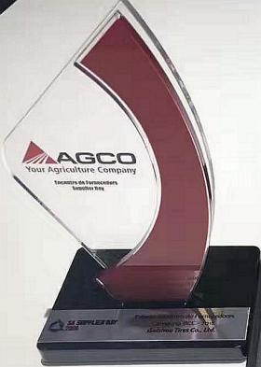
16
Advantage 3: Stable Product Quality and Leading Industry
It has passed the ISO9001 and IATF16949 Quality Management System Certifications, which are globally recognized, and has a first-class quality management system and quality control ability.
The products are widely used in various complex working conditions with stable quality, excellent performance and wide applicability, and their comprehensive performances are in the forefront of the industry. It provides product support and high-quality services to well-known customers in various industries, such as Lingong Group, Sany Heavy Industry, XCMG Group, CNH, Weichai Special Vehicle, FAW Jiefang, China Heavy Truck, BOMAG, AGCO, John Deere, Guangxi Liugong, Kalma, CRRC, Jinlong Bus, and Zhongtong Bus, etc.

Slide 18
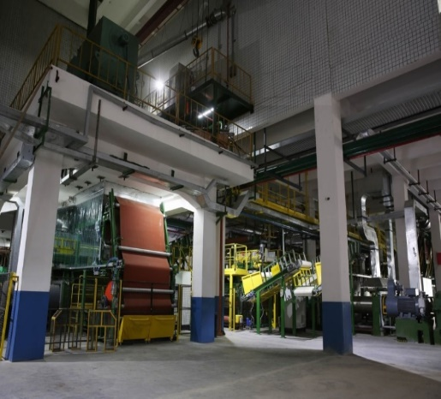
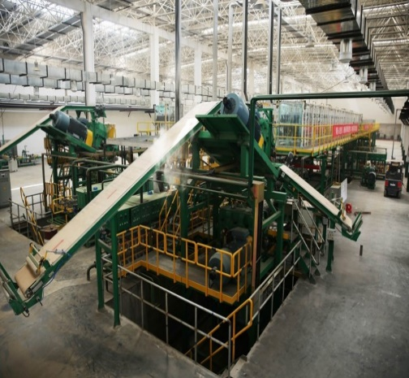
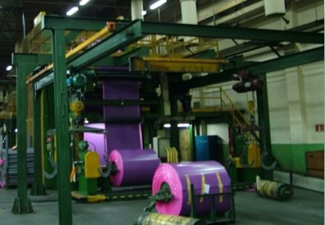
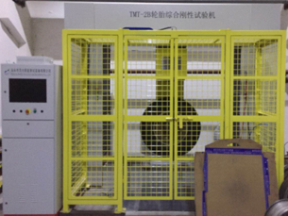
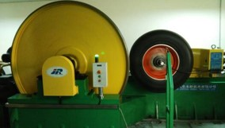
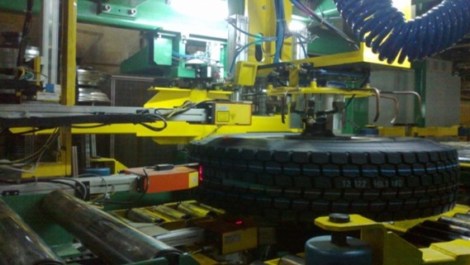
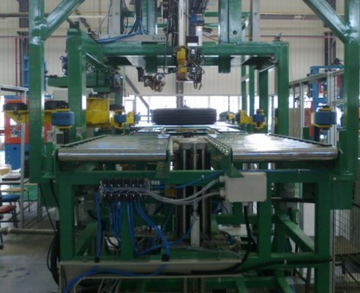
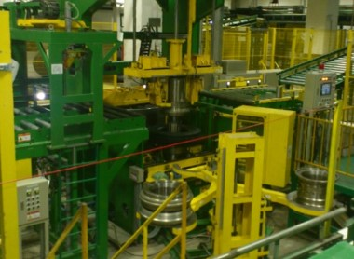
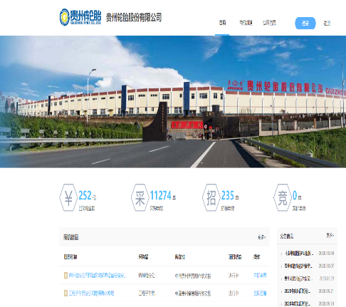
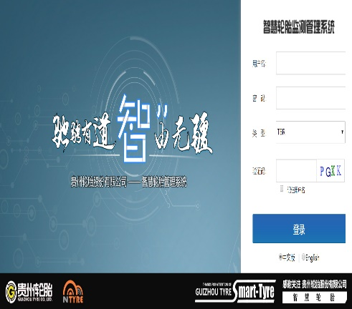
17
Advantage 4： The Level of Intelligence, Informatization and
Automation is Leading in China
Temperature Mixing Equipment | Tread Compound Extrusion Equipment | Calendering Equipment | Stiffness Testing Equipment | Rolling Resistance Testing Equipment
Out of Roundness Detection Equipment | Automatic Dynamic Balance Testing Equipment | Uniformity Testing Equipment | Information Procurement Platform | Smart Tire System

Slide 19
18
Advantage 5：5G Factory

Slide 20
19
Advantage 6：Sales Service Network Globalization
Domestic
It has a professional service team of more than 20 talents,
and more than 500 brand agents nationwide
It has set up special service stations in major cities in
China, and it is committed to providing supporting
customers with high-quality professional services
WELCOME ONLINE CONSULTATION
Provide the professional answers to your questions on product and service
400-100-0589
International
The sales network covers more than 130 countries and regions around the
world;
It has authorized more than 30 listed service providers, who regularly track
the utilization conditions of the products.
It has established a 48h response system and a 7-day issue handling system.
The customers of the OE factory can be provided by the special service provider through appointment to realize fast localized delivery, relieve customer’s inventory pressure, and fast meet the end-terminal market demands.

Slide 21
20
Sales Team

Slide 22
21
Participate in exhibitions

Slide 23
GTC is Your Best Choice
Thank You
July 11，2022

